Slide 1
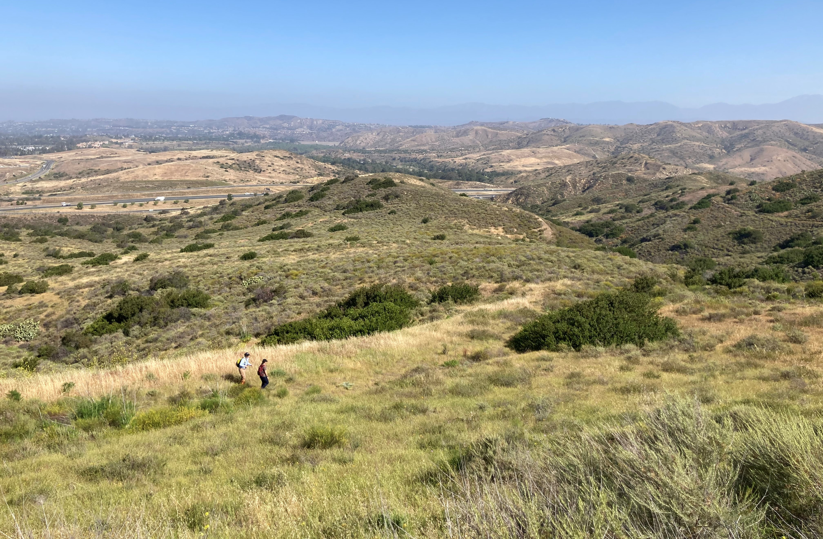
Saddleback Wilderness Overview
Orange County Parks Trails Subcommittee – August 9, 2023
1

Slide 2
Overview
Background
Planning & Improvements
Trail System
Public Access
Survey Feedback
Conclusion
Saddleback Wilderness

Slide 3
Background – Location & Description
Located along Santiago Canyon Road between the intersection of State Roads 241 and 261 and Irvine Lake access
Approximately 430 acres
Four major native habitat communities
Multiple special status wildlife and plant species
Orange County Parks Foundation and NCCP/HCP Conservation Easements

Slide 4
Background – History
1967 – Saddleback Park open for motocross
1984 – Saddleback Park phases out
2014 – Donated to OC Parks by The Irvine Company
2019 – Complete Interim Recreation and Resource Management Plan (IRRMP)
2020 – Conduct baseline biological surveys
2021 – Begin preliminary trail routing
2022 – Initiate interim improvements and install trail network
2023 – Open for managed public access and begin visitor surveys
Saddleback Park motocross in the 1970s–80s *Courtesy of MXA Motocross Action (motocrossactionmag.com)
Saddleback Wilderness in the present day, with recovering native habitats

Slide 5
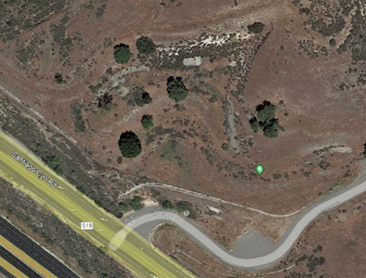
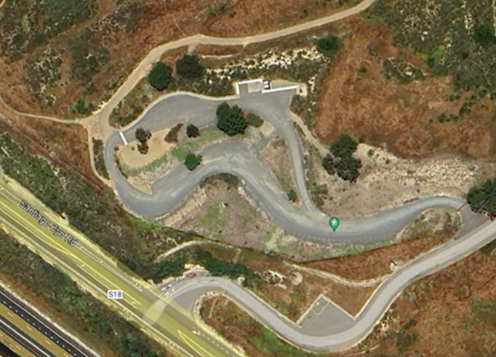
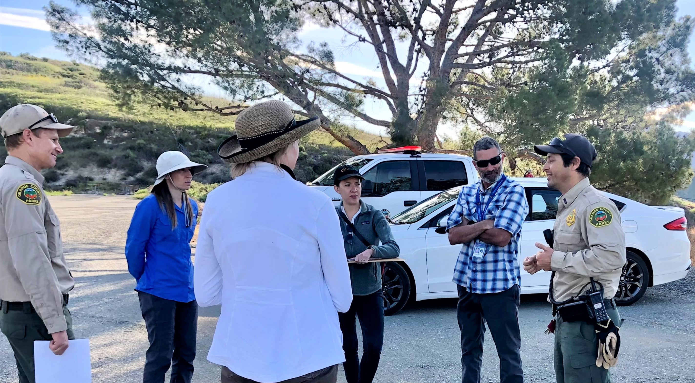
Planning & Improvements
Baseline biological surveys
Parking area
Trail system and lookout
Signage and map
Access plan
Field staff staking a future lookout area
Parking and staging area for Saddleback Wilderness, in 2013 and 2023
Planning process for Saddleback Wilderness, considering recreation opportunities, natural and cultural resources, and facility operations

Slide 6
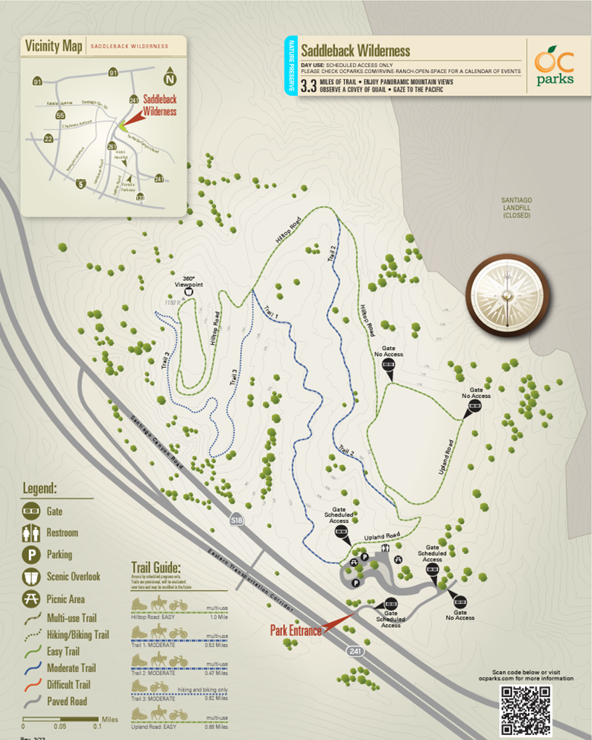
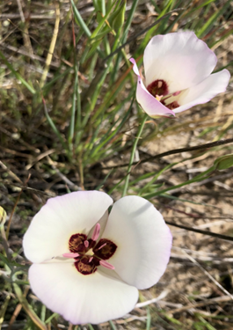
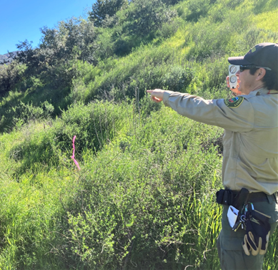
Trail Network
Trail routing
Use of biological surveys
Subject Matter Expert (SME) assessments
Trail installation
Sensitive resources, Catalina mariposa lilies and fossilized whale bones found during SME assessments
Trail assessment

Slide 7
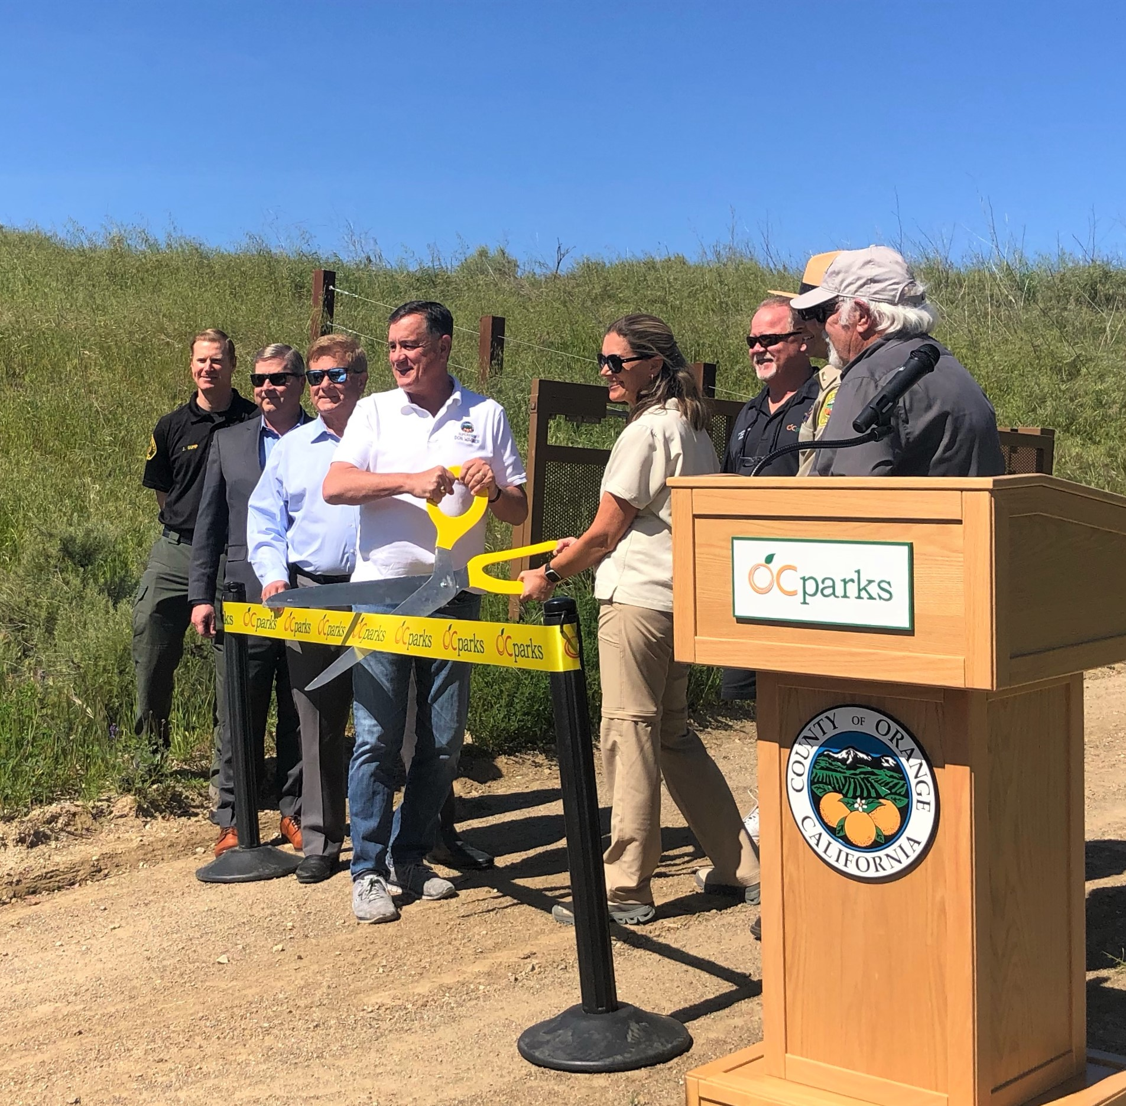
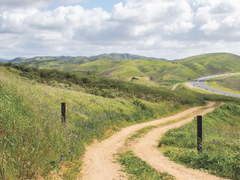
Public Access
Opened March 27, 2023
Self-scheduled access several Saturdays throughout April–May
Trial to evaluate self-scheduled user group-specific access in June
Beginning in July, monthly managed access the first Saturday of each month
Ribbon-cutting ceremony to welcome the public to the newest OC Parks facility

Slide 8
Survey Feedback
1%
4%
1%
6%
7%
4%
6%
33%
13%
60%
25%
34%
36%
13%
* Note: All percentages are rounded, therefore responses may not equal 100%

Slide 9
Survey Feedback
82%
3%
1%
32%
3%
78%
11%
77%
15%
16%
69%
45%
86%
24%
* Note: All percentages are rounded, therefore responses may not equal 100%

Slide 10
Survey Feedback
86%
1%
5%
15%
14%
32%
44%
4%
1%
* Note: All percentages are rounded, therefore responses may not equal 100%

Slide 11
Survey Feedback
7%
22%
47%
43%
1%
24%
55%
* Note: All percentages are rounded, therefore responses may not equal 100%

Slide 12
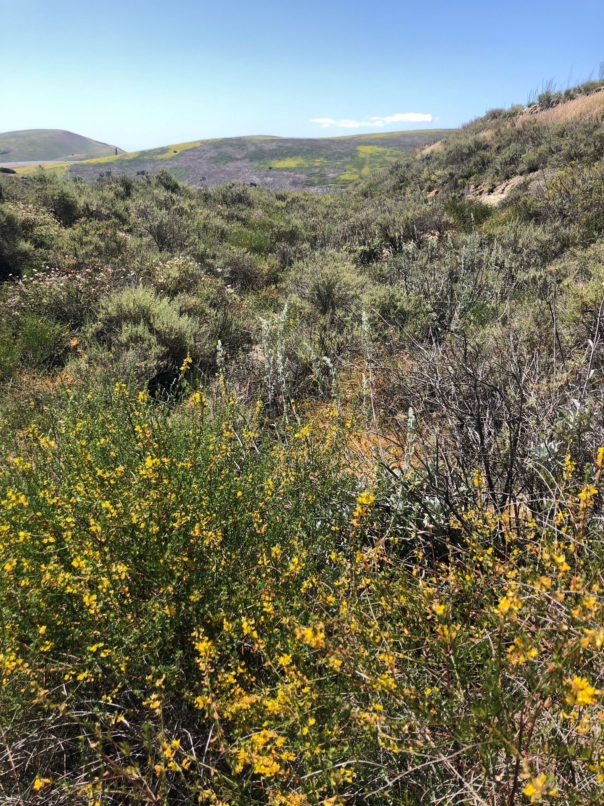
Looking Ahead
Naming of the trails
Reassess trail difficulty ratings
Continue improvements
Native deerweed in bloom

Slide 13
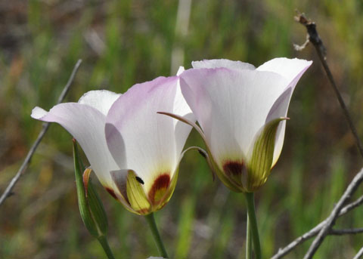
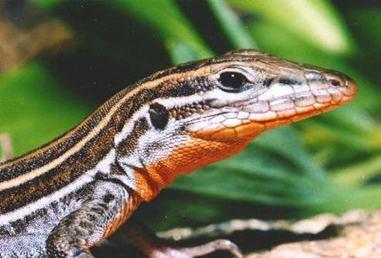
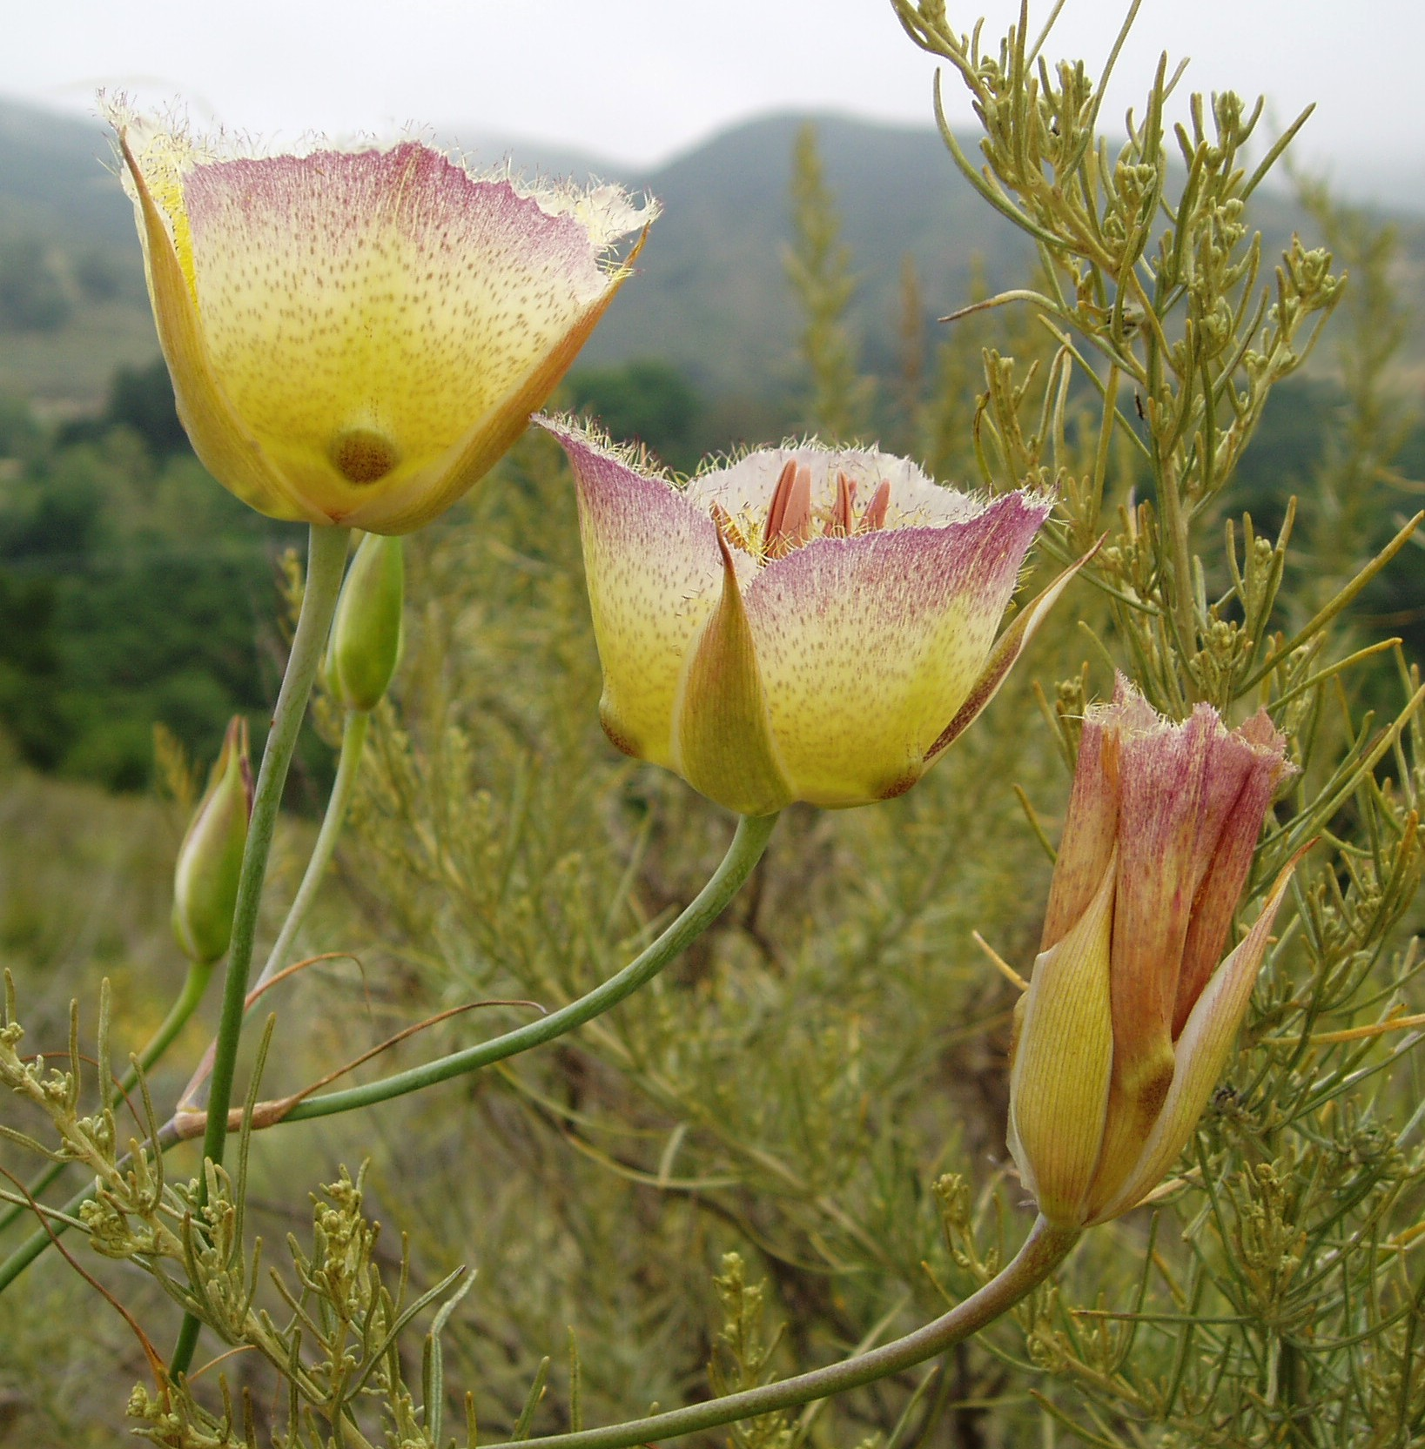
Questions?
Grasshopper Sparrows, Catalina Mariposa Lilies, Orange-Throated Whiptail Lizards, and Intermediate Mariposa Lilies are all special status species in Saddleback Wilderness

